Slide 1
ITA0612 – Technical Presentation
Decision Tree Learning and Representation

Slide 2
INTRODUCTION :
Decision Tree is a supervised machine learning algorithm.
It is used for both classification and regression tasks.
It represents decisions in a tree-like hierarchical structure.
Each internal node tests an attribute.
Each branch represents the outcome of a test.
Each leaf node represents the final prediction or class.
It is one of the most interpretable machine learning models.

Slide 3
Objectives :
Learn patterns from historical data.
Classify data into predefined categories.
Predict outcomes accurately.
Minimize classification errors.
Create an easy-to-understand model.
Support decision-making processes.
Improve prediction efficiency.

Slide 4
WORKING OF DECISION TREE :
Collect the training dataset.
Calculate entropy of the dataset.
Compute information gain for each attribute.
Select the attribute with highest information gain.
Split the dataset into subsets.
Repeat the process recursively.
Stop when all records belong to one class.

Slide 5
ADVANTAGES :
Easy to understand and interpret.
Simple to visualize.
Handles numerical and categorical data.
Requires minimal data preprocessing.
Fast prediction after training.
Supports feature importance analysis.
Suitable for real-world decision-making.

Slide 6
DISADVANTAGES :
Prone to overfitting.
Sensitive to noisy data.
Small data changes may produce different trees.
Can become very large.
Lower accuracy than ensemble methods.
Biased toward attributes with many values.
Requires pruning for better performance.

Slide 7
APPLICATIONS :
Medical diagnosis.
Loan approval systems.
Fraud detection.
Customer churn prediction.
Email spam filtering.
Recommendation systems.
Credit risk assessment.

Slide 8
SAMPLE INPUT :
Outlook | Temperature | Humidity | Wind | Play Tennis
Sunny | Hot | High | Weak | No
Sunny | Hot | High | Strong | No
Overcast | Hot | High | Weak | Yes
Rain | Mild | High | Weak | Yes
Rain | Cool | Normal | Weak | Yes
Rain | Cool | Normal | Strong | No
Sunny | Mild | High | Weak | No
Overcast | Cool | Normal | Strong | Yes

Slide 9
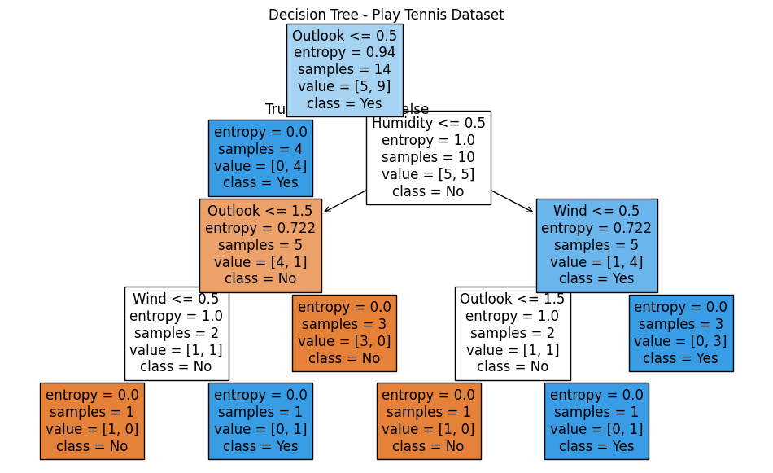
SAMPLE OUTPUT :

Slide 10
Version Spaces and Candidate Elimination

Slide 11
INTRODUCTION :
Version Space is a concept learning method in Machine Learning.
It contains all hypotheses consistent with the training data.
Candidate Elimination is a supervised learning algorithm.
It updates hypotheses using positive and negative examples.
It maintains two boundaries: Specific (S) and General (G).
It gradually reduces the hypothesis space.
It helps identify the most accurate concept.

Slide 12
Objectives :
Learn concepts from labeled training data.
Identify all consistent hypotheses.
Eliminate incorrect hypotheses.
Reduce the hypothesis search space.
Improve classification accuracy.
Learn incrementally from new examples.
Build reliable prediction models.

Slide 13
WORKING OF VERSION SPACES AND CANDIDATE ELIMINATION :
Initialize the Specific boundary (S).
Initialize the General boundary (G).
Read each training example.
Generalize S for positive examples.
Specialize G for negative examples.
Remove inconsistent hypotheses.
Continue until all examples are processed.

Slide 14
ADVANTAGES :
Finds all consistent hypotheses.
Learns incrementally from data.
Reduces unnecessary hypotheses.
Provides accurate concept learning.
Helps understand hypothesis space.
Supports supervised learning.
Suitable for educational and research purposes.

Slide 15
DISADVANTAGES :
Sensitive to noisy data.
Requires consistent training examples.
Computationally expensive for large datasets.
Large hypothesis space increases complexity.
Difficult to apply in real-world noisy environments.
Memory requirements may increase.
Less suitable for complex datasets.

Slide 16
APPLICATIONS :
Medical diagnosis.
Pattern recognition.
Knowledge discovery.
Rule-based expert systems.
Educational concept learning.
Artificial Intelligence research.
Machine Learning algorithm analysis.

Slide 17
SAMPLE INPUT :
Outlook | Temperature | Humidity | Wind | Play Tennis
Sunny | Hot | High | Weak | No
Sunny | Hot | High | Strong | No
Overcast | Hot | High | Weak | Yes
Rain | Mild | High | Weak | Yes
Rain | Cool | Normal | Weak | Yes
Rain | Cool | Normal | Strong | No
Overcast | Cool | Normal | Strong | Yes

Slide 18
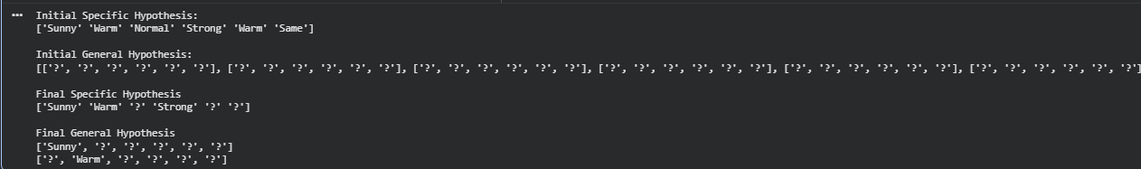
SAMPLE OUTPUT :

